Slide 1


Olist E-commerce Data 2016 – 2018
SCTP – DSAI – 1F
Team 5
Team Lead - Kok Leong,
Data Engineers - Sen Kwan, Yen Kai, Sara,
Business Analysts - Minheaa, Audrey

Slide 2
Executive Summary
This analysis evaluates seller performance on the e-commerce platform to identify underperforming sellers, improve sales effectiveness, and enhance the overall customer journey. A focus was placed on optimizing platform profitability while maintaining a strong branding value through seller trustworthiness and operational efficiency. The performance of individual sellers has a direct impact on the platform’s revenue, brand reputation, and the buyer’s satisfaction.

Slide 3
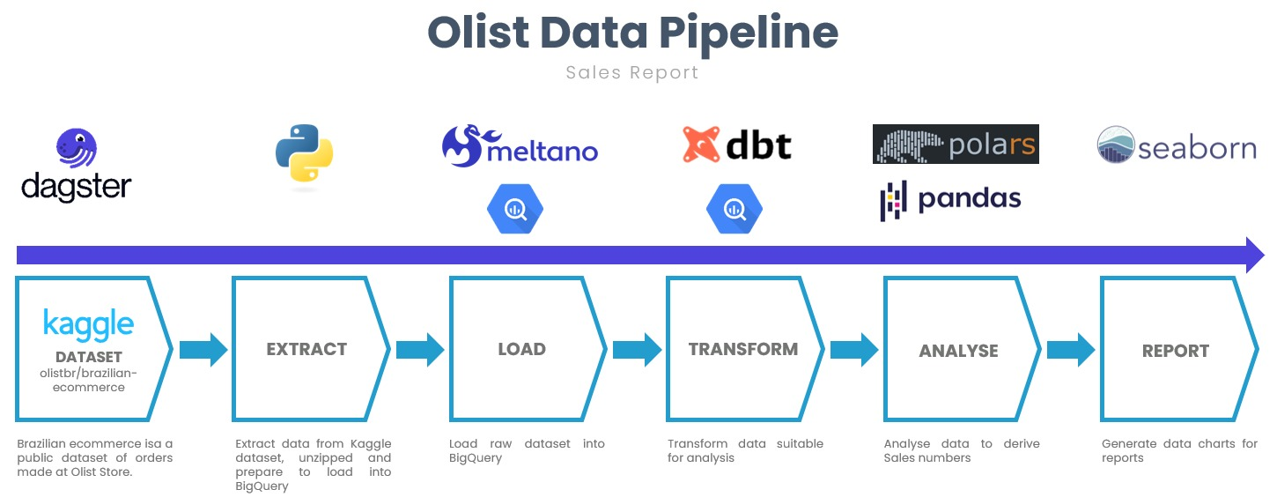

Introduction
This analysis summarizes monthly total sales, commissions earned by the platform, and total order volume across all sellers for the 12-month period. The data reflects active seller performance on the platform, excluding 610 records from the products dataset that lacked product category data. All other records across datasets are retained.

Slide 4
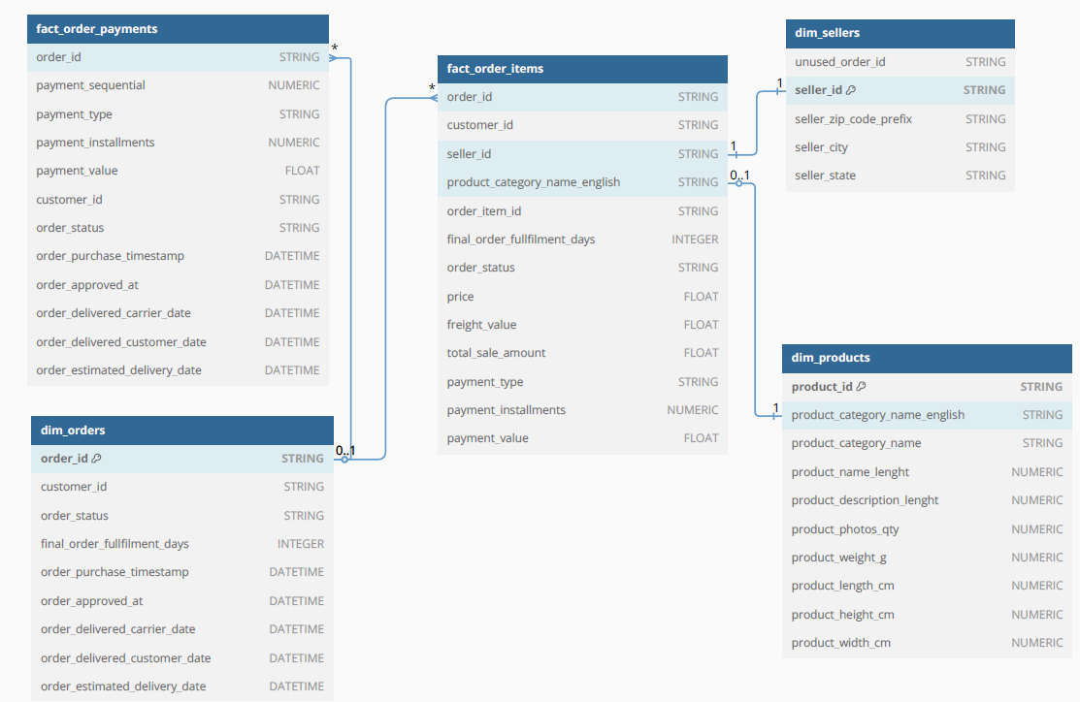
Schema Summary
🔍 How Seller Performance Insights Are Derived
dim_sellers
fact_order_items
dim_products
This model shows how seller, product, and transactional data are interconnected. These relationships allow for segmentation of sellers based on sales, fulfillment efficiency, review sentiment, and geography.

Slide 5
Methodology Dataset
Olist E-Commerce Public Dataset
The dataset has information of 100k orders from 2016 to 2018 made at multiple marketplaces in Brazil. Its features allows viewing an order from multiple dimensions: from order status, price, payment and freight performance to customer location, product attributes and finally customer reviews.
Approach:
Merged relevant tables (sellers, orders, order items, products).
Calculated monthly revenue per seller and mapped against assumed cost per seller.
Aggregated customer ratings and performed sentiment analysis on reviews.
Clustered sellers by revenue, rating, category spread, and location distance.

Slide 6
Data Description
sellers_dataset.csv: Seller ID and location
order_items_dataset.csv: Product, order, and seller linkage
orders_dataset.csv: Order status and customer ID
reviews_dataset.csv: Customer ratings and written reviews
products_dataset.csv: Category and product metadata
excluded 610 rows with missing product categories.
Assumptions:
Operational cost per seller: R$100/month
Platform revenue share: 10% of gross sale price

Slide 7
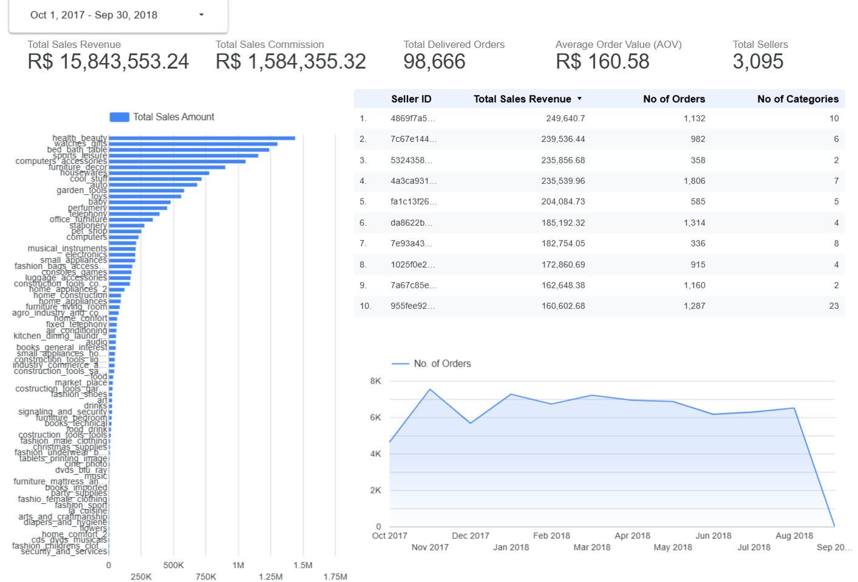
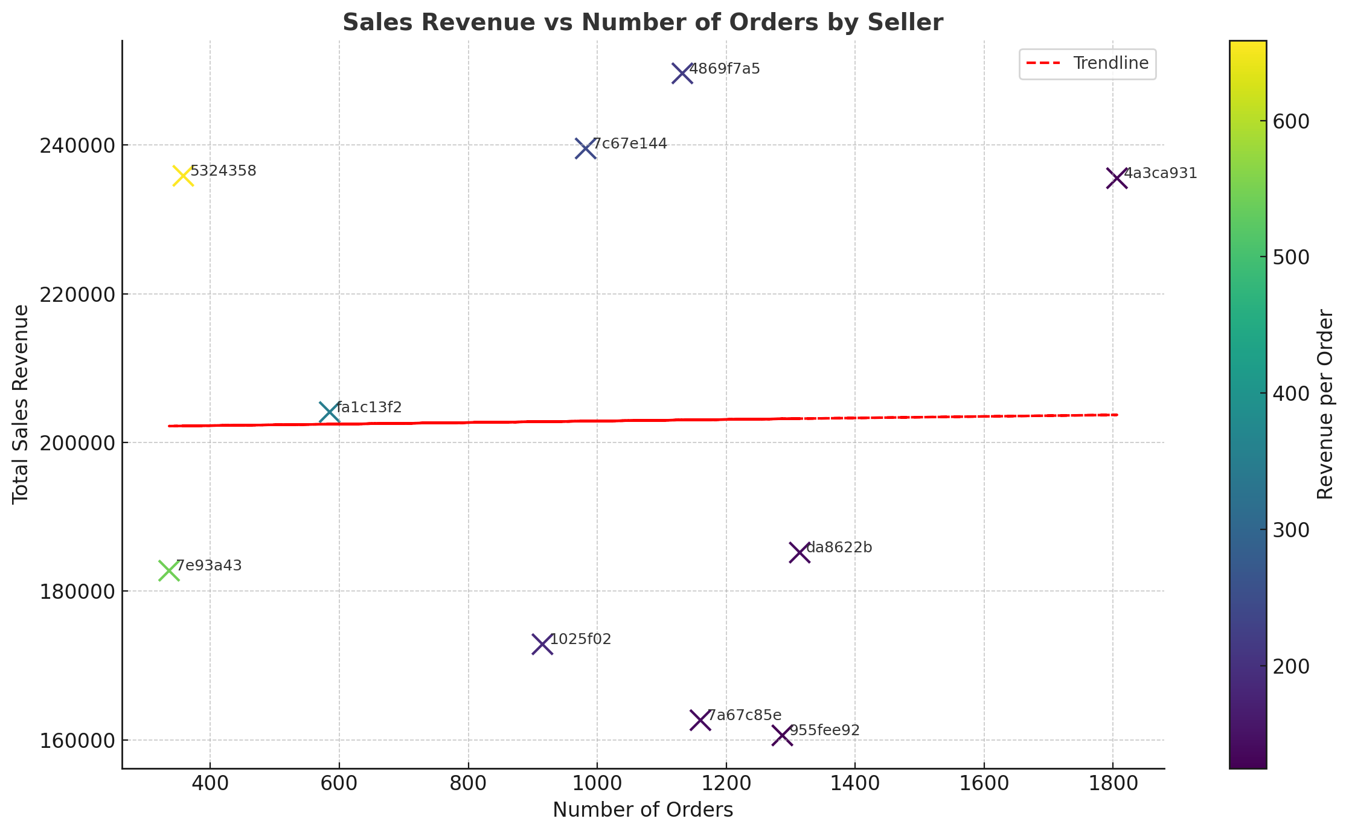
Total Sellers
3,095
02K4K6K8KOct 2017Nov 2017Dec 2017Jan 2018Feb 2018Mar 2018Apr 2018May 2018Jun 2018Jul 2018Aug 2018Sep 20…No. of Orders
R$ 1,584,355.32
R$ 15,843,553.24
Sales Revenue
R$ 1,584,355.32
Sales Commission
98,666
Total Orders
R$ 160.58
Avg Order Value
3095
Total Sellers
Product Category
0/10 Top Sellers are from
Health & Beauty —
Best-Selling Category R$1,441,228
Nov 2017 – 7544 orders
Sept 2018 – 18 orders
High Revenue with Fewer Orders Computers
Lower Revenue with Most Orders Bed Bath Table

Slide 8
E-commerce Sales Insights
📈 Total Gross Sales Revenue: The platform generated significant monthly revenue from seller product sales, with peak months occurring between November 2017 and February 2018—likely aligned with holiday and seasonal demand.
💰 Platform Commission (10%): Using a fixed commission rate, the platform’s monthly profit from sellers scaled directly with sales volume. On average, 10% of gross monthly sales provided a consistent revenue stream for operations.
📦 Total Orders per Month: The total order count fluctuated throughout the year, with the highest order volume observed in November 2017, consistent with peak sales revenue trends. The dip in July–August 2018 may be due to seasonality or macroeconomic influences.
🗂️ Product Category Revenue Share: Despite the removal of 610 records due to missing product category names, the remaining dataset showed a dominant contribution from Electronics, Furniture, and Health & Beauty categories, reflecting both value and volume drivers of sales.

Slide 9
Analysis and Findings
Seller Contribution: Sellers in the bottom 25% generated less than 5% of gross sales and incurred net losses after factoring in estimated monthly support costs. These losses are based on a comparison of platform commission (10% of sales) versus a fixed monthly operational cost (e.g., $XX/month).
Recent Revenue Trends: Within the last 1m, seller revenue distribution remained consistent with previous patterns, indicating the persistence of underperformance among long-tail sellers.
Ratings: 37% of underperforming sellers had average customer ratings below 3.5, often associated with long delivery windows and negative review sentiment.
Product Mix: High-performing sellers offered a broader selection of SKUs and spanned more product categories, increasing exposure to diverse customer needs.
Location Mismatch: Sellers operating from different states than their customers contributed significantly to delivery delays and customer dissatisfaction.
Sentiment Analysis: Review sentiment in the current month correlated strongly with star ratings. Sellers with consistently negative sentiment had elevated return/refund rates and lower repurchase potential.

Slide 10
Recommendations
Performance-based seller tiering. Add visible labels such as "Most Recommended Seller" or "Trusted Seller" for sellers meeting defined KPIs (ratings, delivery time, sentiment, volume).
Rebalance operational cost structure and commissions based on seller performance: Sellers generating losses for >1m can receive reduced platform exposure or conditional assistance.
Seller Training Program: Provide onboarding resources and fulfillment best practices, especially those who have underperformed for 2 or more consecutive months.
Regional fulfilment through seller incentives: Encourage logistics optimization by favoring regionally closer sellers in customer recommendations to improve delivery experience.
Sentiment analysis for seller quality control: Conduct monthly sentiment analysis on seller reviews (0m snapshot) to detect service quality issues early. Alert or assist sellers showing sharp negative trends.

Slide 11
Conclusion
This report highlights the importance of strategic seller management in driving profitability, brand trust, and customer satisfaction. Implementing tiered seller programs and leveraging sentiment data can significantly improve the e-commerce platform’s health and long-term growth. Sellers must be both supported and held accountable to standards that reflect the brand’s value proposition.
For Olist, this implies that enforcing stricter service level agreements (SLAs) or providing tools and incentives to improve seller logistics and dispatch efficiency could directly enhance customer experience and, consequently, seller ratings. Furthermore, total sales for each seller are influenced by both the sheer number of products sold and their average price, reinforcing the need for sellers to balance volume and value in their offerings.

